Slide 1



AP Computer Science Principles
AP Computer Science High Schoolers in Computer Science Path!

Slide 2
 | Computer Science | Computer Science Principle
Curricular Focus | Problem solving and object-oriented programming | Big ideas of computer science (including algorithms and programming)
Programming Language | Java | Teachers choose the programming language
End-of-Course Exam Experience | Multiple-choice (single-select) Free-response questions | Multiple-choice (single- and multiple-select) questions, some related to a reading passage about a computing innovation Create performance task administered by the teacher; students submit digital artifacts

Slide 3
AP Computer Science Principles
By: Pujith Veeravelli

Slide 4
AP CSP Class
In the AP Computer Science Principle course, you will learn the basics and fundamentals of programming - with the assistance of a language/block-based programming resource. You will also learn about computing innovations, why they matter, ethics, etc.
You are expected to “explore” as a part of this course and create a digital artifact for the “Explore” task, in which you will research and explain a new computing/technological innovation.
Furthermore, with your knowledge about programming fundamentals - variables, algorithms, abstractions, etc. - you are expected to create a program at the end of the course as a part of the “Create” task.

Slide 5
Syllabus/Schedule
1: The World You Live In
Bits, Binary, & Hexadecimal, Exploring Innovations, How Innovation Affects Our Lives
2: Developing Programming Tools
Introduction to Programming, Algorithms (the basics and pseudocode), Variables, Comparison, Logical Operators, and Conditional Execution, Iteration (For and While loops), Functions (parameters and return values), String and Lists, and Abstraction
Will use a language/block-based programming language in addition to pseudocode to explore these concepts
3: Information and the Internet
How the Internet works, Search Engines, Cybersecurity, Cryptography, Data on the Internet
4: Data
Data Acquisition, Manipulation, and Visualization; Advanced Algorithms (Searching and Sorting)
5: Global Impacts
*The curriculum is subject to change!

Slide 6
Computing Innovations
How does technology impact your life?
There is technology all around us; from our microwaves to the computers that are carried around in our pockets, called smartphones.
Which computing innovation has had the most impact on you?

Slide 7
Bits, Binary, and Hexadecimal

Slide 8
Bits and Bytes
At the smallest scale in the computer, information is stored as bits and bytes.
Bits:
a "bit" is atomic: the smallest unit of storage
A bit stores just a 0 or 1
"In the computer it's all 0's and 1's" ... bits
Anything with two separate states can store 1 bit
In a chip: electric charge = 0/1
In a hard drive: spots of North/South magnetism = 0/1
A bit is too small to be much use
Group 8 bits together to make 1 byte

Slide 9
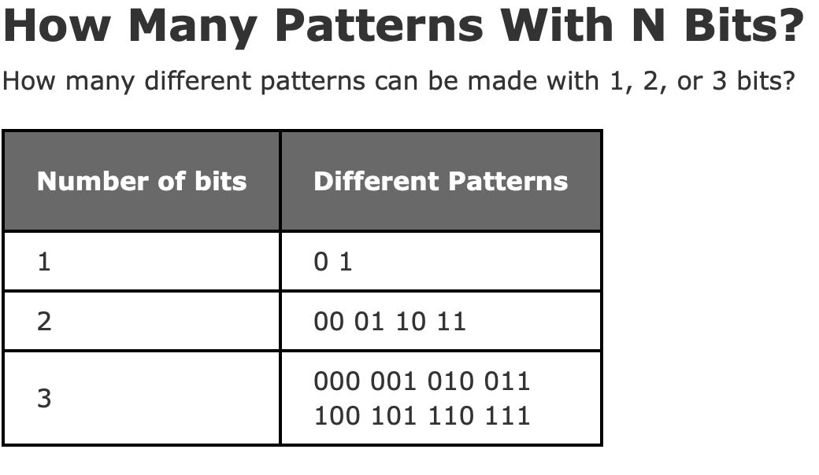
Bits and Bytes cont.
Bytes:
One byte = collection of 8 bits
e.g. 0 1 0 1 1 0 1 0
One byte can store one character, e.g. 'A' or 'x' or '$'

Slide 10
More about Bytes
"Byte" - unit of information storage
A document, an image, a movie .. how many bytes?
1 byte is enough to hold about 1 typed character, e.g. 'b' or 'X' or '$'
All storage is measured in bytes, despite being very different hardware
Kilobyte, KB, about 1 thousand bytes
Megabyte, MB, about 1 million bytes
Gigabyte, GB, about 1 billion bytes
Terabyte, TB, about 1 trillion bytes (rare)

Slide 11
What is Binary?
In mathematics and digital electronics, a binary number is a number expressed in the base-2 numeral system or binary numeral system, which uses only two symbols: typically "0" and "1". There are only two values: 0 and 1, true and false, etc.
This number system is the basis for all binary code, which is used to write data such as the computer processor instructions used every day.
The American Standard Code for Information Interchange (ASCII), uses a 7-bit binary code to represent text and other characters within computers, communications equipment, and other devices. Each letter or symbol is assigned a number from 0 to 127.

Slide 12
Binary Conversions
Unlike our normal everyday system for counting numbers - which has ten digits and thus is a base-10 system - binary is base 2 (there are only 2 digits).
In our counting system, everything is based on the powers of ten; this is how numbers increase from the ones place, to the tens place, to the hundreds place, etc.
On the other hand, binary is based on powers of 2.
Binary to decimal?
Get the decimal values of all the “1s” in the binary number by place value and add them up
Practice: https://drive.google.com/file/d/0B1CQsjPV1w0acDljOEhLTlR1Y00/view?usp=sharing

Slide 13
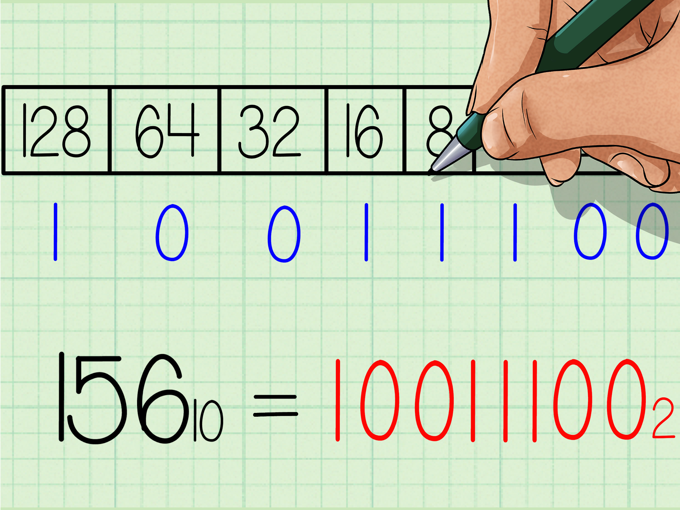
Conversion?
By Division: 29dectobinarymultiplication.mp4
Another Method:
Practice: https://drive.google.com/file/d/0B1CQsjPV1w0acDljOEhLTlR1Y00/view?usp=sharing

Slide 14
What is Hexadecimal?
Hexadecimal is a positional system that represents numbers using a base of 16. Unlike the common way of representing numbers with ten symbols, it uses sixteen distinct symbols, most often the symbols "0"–"9" to represent values zero to nine, and "A"–"F" to represent values ten to fifteen.
It is base-16 (16 digits)
Hexadecimal can be used to write large binary numbers in just a few digits. It makes life easier as it allows grouping of binary numbers which makes it easier to read, write and understand. It is more human-friendly.

Slide 15
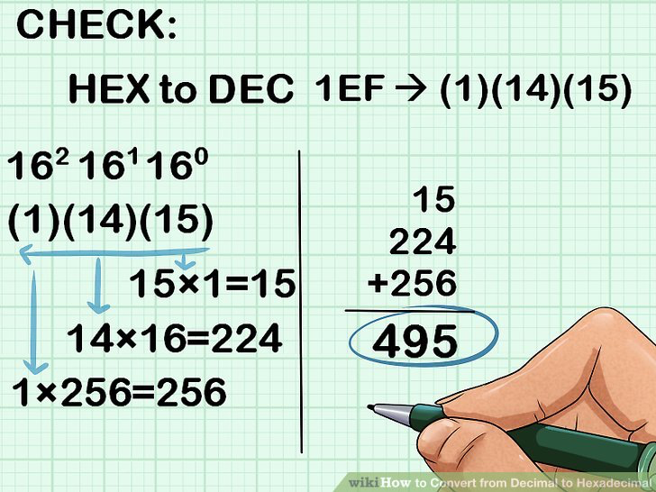
Hexadecimal conversions
The division method is the same idea as the binary conversion: https://drive.google.com/file/d/0B00cKGscEL1YSjdIQ292dnlUbjQ/view?usp=sharing
Can also use the powers of 16 (like we did with binary) but you would need to memorize the powers.
Hex to decimal
Practice: https://docs.google.com/document/d/1gOpi7tqH996h7cS9-p0p-3nSxyC1mxYfaMycbQISfFg/edit?usp=sharing:

Slide 16
What is Octal?
The octal numeral system, or oct for short, is the base-8 number system, and uses the digits 0 to 7.
Octal is used when the number of bits in one word is a multiple of 3. It is also used as a shorthand for representing file permissions on UNIX systems and representation of UTF8 numbers, etc.

Slide 17
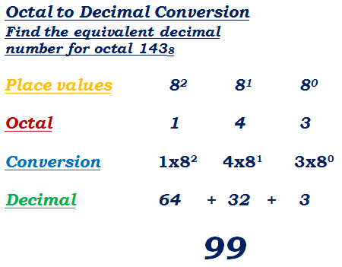
Octal Conversions
Division method (most common and easiest): https://drive.google.com/file/d/0B00cKGscEL1YVFF4YkFZZE9uZUU/view?usp=sharing
Octal back to Decimal:

Slide 18
Binary to Hex
Essentially just group the binary number into multiple groups with 4 binary digits in each. Convert each group from binary to decimal. This is basically your Hex number, but don;t forget to replace the numbers that are greater than 10 with their letter counterparts.
Do the same thing backwards to convert from Hex to binary.
Video: https://drive.google.com/file/d/0B00cKGscEL1YU0ViaGI4cDVfdzQ/view?usp=sharing

Slide 19
Binary to Octal
Essentially the same process as binary to hexadecimal. Except this time, you should group the binary numbers into groups of 3.

